Slide 1
Interactive Music Player
Project creators :
GURINDER SINGH(2210990337)
GURKIRAT SINGH(2210990339)
GYANARANJAN BISWAL(2210990354)
Submitted To :
Dr. Rajender Kumar

Slide 2

Introduction
Welcome to “Music Player," a unique and interactive music experience crafted with the fusion of React js. In the world of code and creativity, we've harmonized these languages to bring you a music player that goes beyond the ordinary.

Slide 3
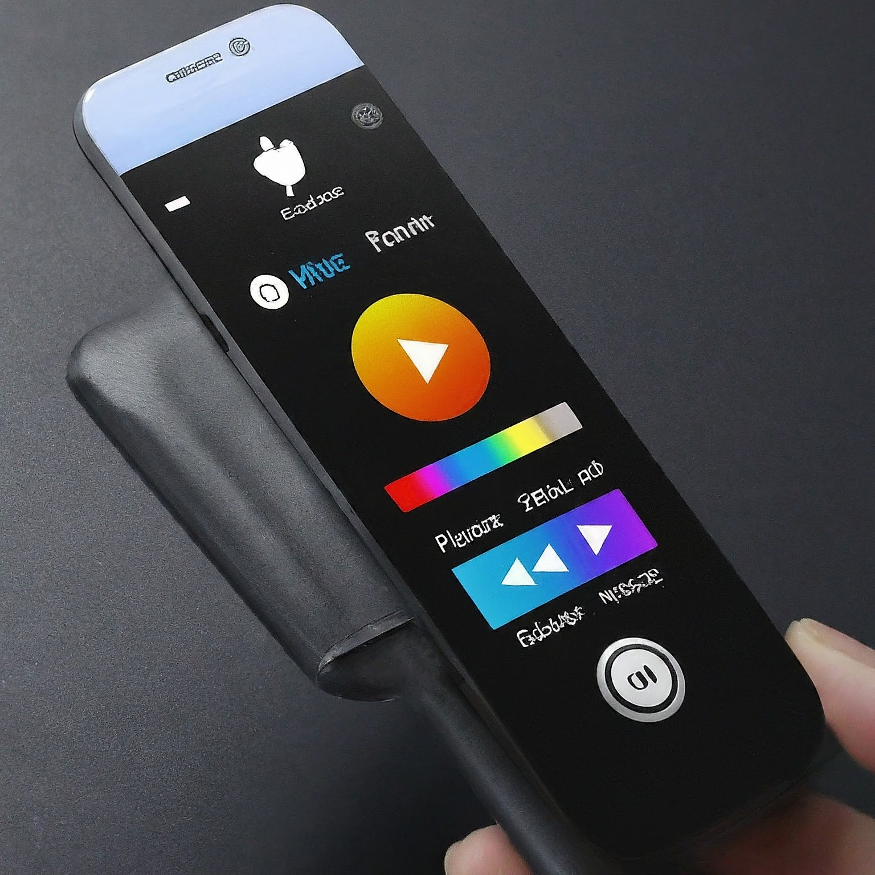

Why React JS?
• A JavaScript library for building user interfaces
• Uses components to structure the UI
• Enables creating reusable and interactive elements
Why Use React JS for a Music Player?
• Component-based structure promotes organization
• Efficient for managing state changes (play/pause, volume)
• Enhances user experience with interactive features

Slide 4
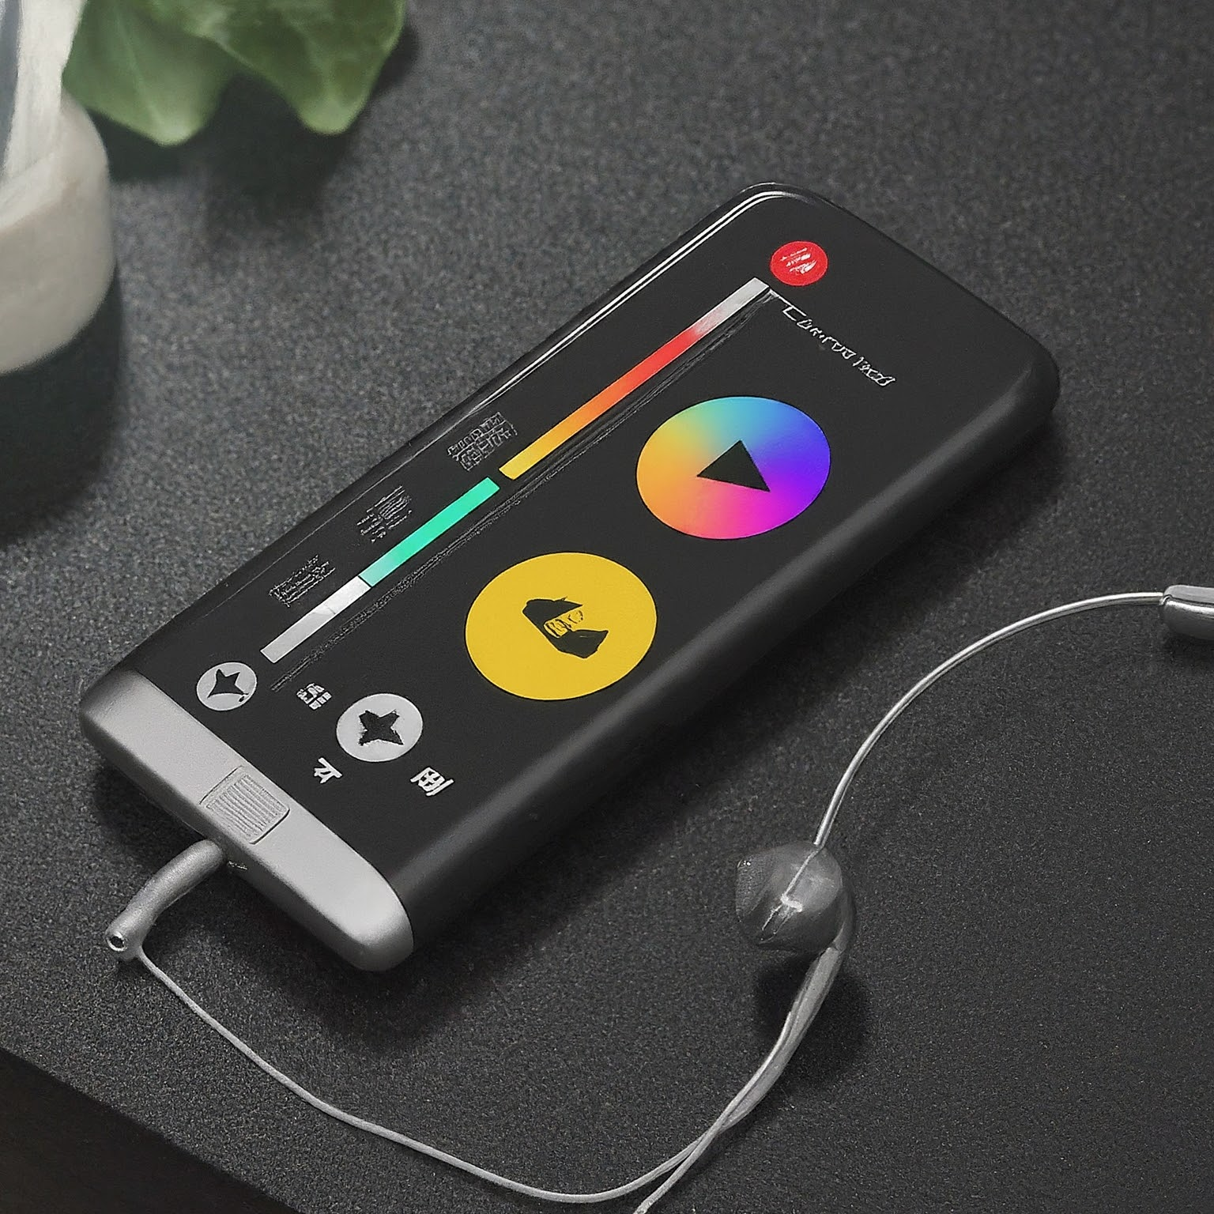
Project setup
•Setting Up the Development Environment
-Node.js and npm (or yarn) installation (https://nodejs.org/en/download)
-Code editor of your choice (Visual Studio Code, Atom, etc.)
•Creating a React Project
-create-react-app my-music-player (replace with your preferred name)
-Project structure overview (components, styles, etc.)
Speaker Notes
Before we dive into coding, let's set up our development environment. We'll need Node.js and npm (or yarn) installed on our system. These tools allow us to manage JavaScript packages and dependencies. You can download Node.js from the official website. Once installed, we can use the create-react-app command to create a new React project. This command will set up the necessary project structure with folders for components, styles, and other essential files.pen_spark

Slide 5
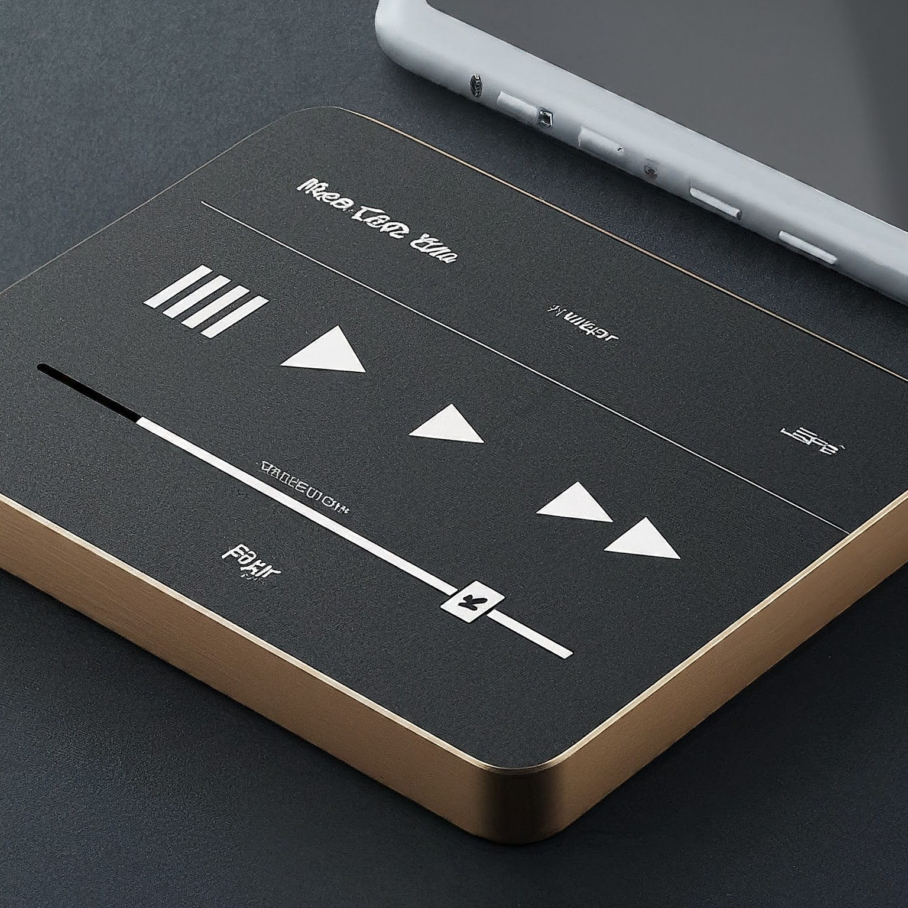
Core Components
•Building the Music Player with React Components
-Audio component: Manages audio playback functionality
-Playlist component: Displays and manages the list of songs
-Controls component: Provides play/pause, volume, and seek
functionality
-Visualizer component (Optional): Creates visual representations of the
audio.

Slide 6

State Management
•Keeping Track of Player State
-Using React's state management for play/pause, volume, current song
-Updating state based on user interactions (clicks, slider changes)
-Conditional rendering based on state values (play/pause button icons)
Speaker Notes
To manage the dynamic behavior of our music player, we'll leverage React's state management capabilities. React components can maintain their own state, which holds information about the component's current condition. In our case, the state will track properties like playback state (playing/paused), volume level, and the currently playing song. User interactions, such as clicking the play/pause button or adjusting the volume slider, will trigger updates to the component's state. This updated state will then be reflected in the UI through conditional rendering. For example, the play/pause button icon will change based on whether the audio is currently playing or paused.

Slide 7
Styling and Design
•Creating a User-Friendly Interface
-Applying CSS styles for visual elements (buttons, progress bars)
-Designing a layout that promotes usability and aesthetics
-Considering responsiveness for different screen sizes
Speaker Notes
The visual appeal and user experience of our music player are crucial. We'll utilize

Slide 8
Thanks!

